Slide 1
18-551 | S’12 | Group #1 APPNAME GOES HERE
Alex Baran
James Chun
Tom Keagle

Slide 2
The Problem
Tourism
Language barriers
Limited translations

Slide 3
The Solution
Android app to translate the world
Capture image input
Get translated text output

Slide 4
More Specifically
Capture image of foreign text
*Segment characters
*Use OCR to convert to ASCII
Recombine words
*Translate to another language
(*) – Major tasks

Slide 5
Previously, in 18-551
Album Digitization
Minimum Average Correlation Energy (MACE) filters
Handwriting Recognition
Thresholding
Segmentation
Support Vector Machine (SVM)
License Plate Recognition
Adaptive Binarization

Slide 6
Current Plan
Implement Segmentation
Image preprocessing
Character -> word recombination
Create OCR
MACE filters
SVM & PCA
Translate in JavaScript

Slide 7
Character Segmentation
Experimented with different implementations
Connected-Component based methods [Ohya et al.]
Binarization with local thresholding, detection with gray-level difference of shapes and sizes
Pros
Able to extract and recognize chars
Good under varying illuminating conditions
Cons
Susceptible to noise
Text alignment is restricted
Upright, Not connected, monochrome
J. Ohya, A. Shio, and S. Akamatsu, Recognizing Characters in Scene Images,
IEEE Transactions on Pattern Analysis and Machine Intelligence, 16 (2) (1994) 214-224.

Slide 8
Character Segmentation
Current Approach – Edge Detection
Morphological Approach [Hasan and Karam]
RGB components form a weighted grayscale
Edges are identified using a morphological gradient operator
Adaptive thresholding for binary edge image
Usage of dilation and erosion to form candidate regions, remove noise
Pros
Robust to noise, insensitive to skew and text orientation
Cons
Current implement seems susceptible to illuminating conditions
Yassin M. Y. Hasan and Lina J. Karam, Morphological Text Extraction from Images, IEEE Transactions on Image Processing, 9 (11) (2000) 1978-1983.

Slide 9
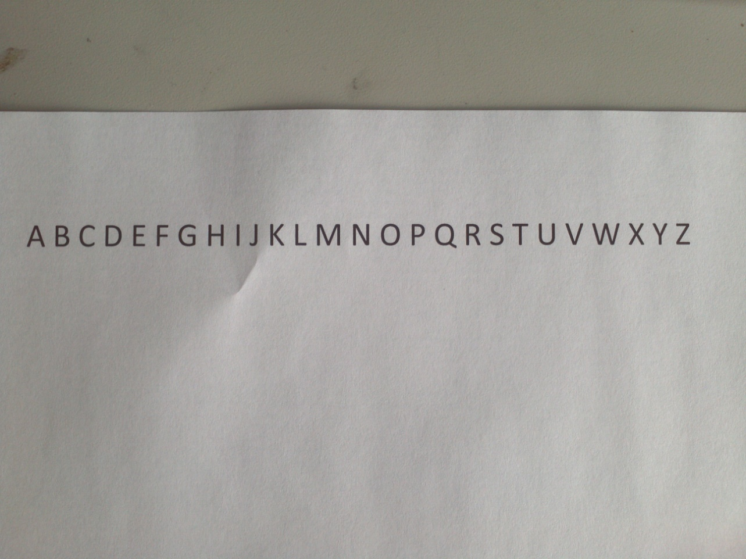
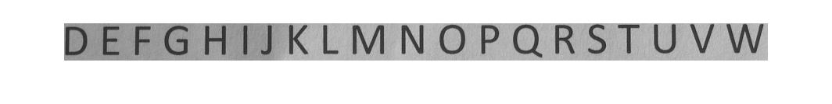
Character Segmentation

Slide 10
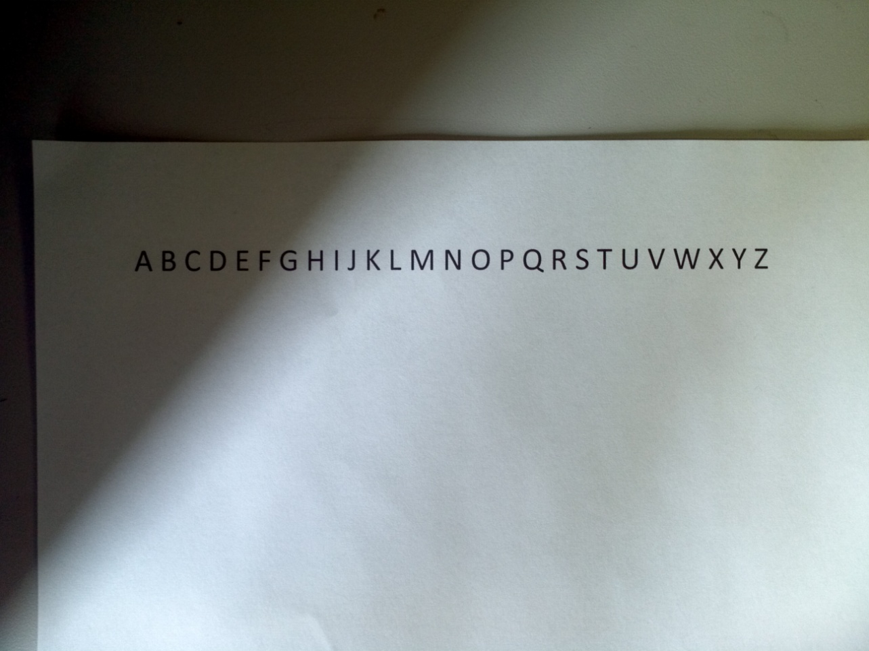
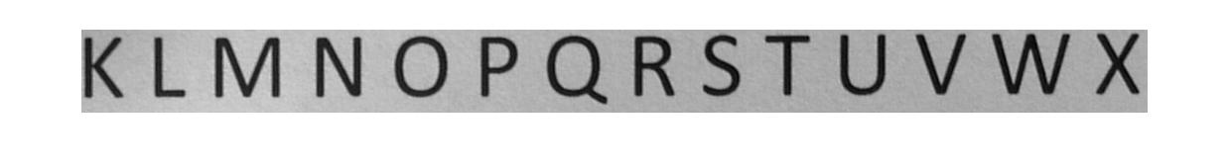
Character Segmentation

Slide 11
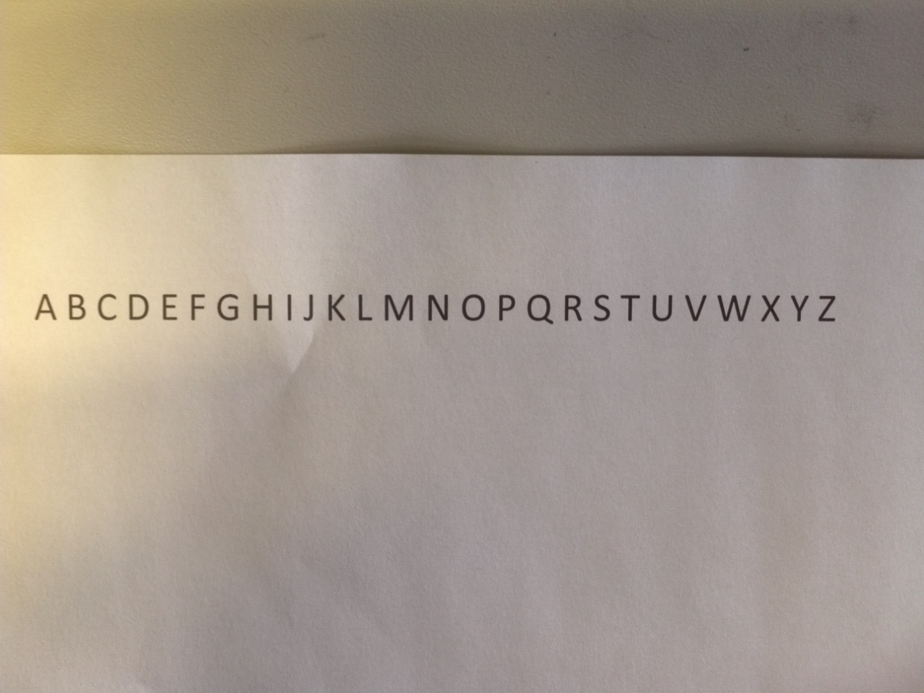
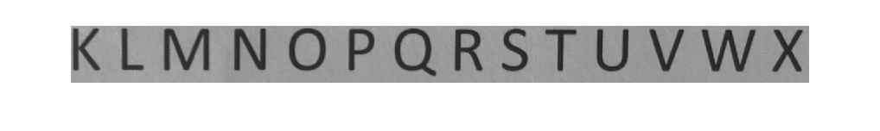
Character Segmentation

Slide 12
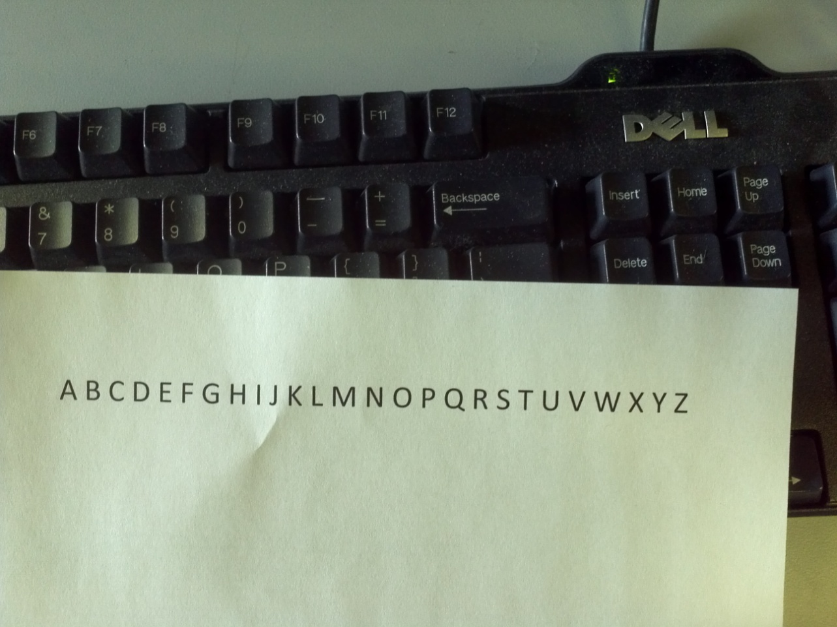
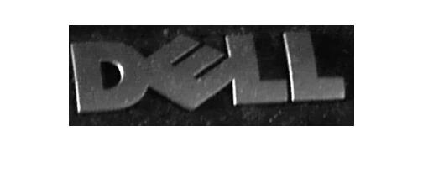
Character Segmentation

Slide 13
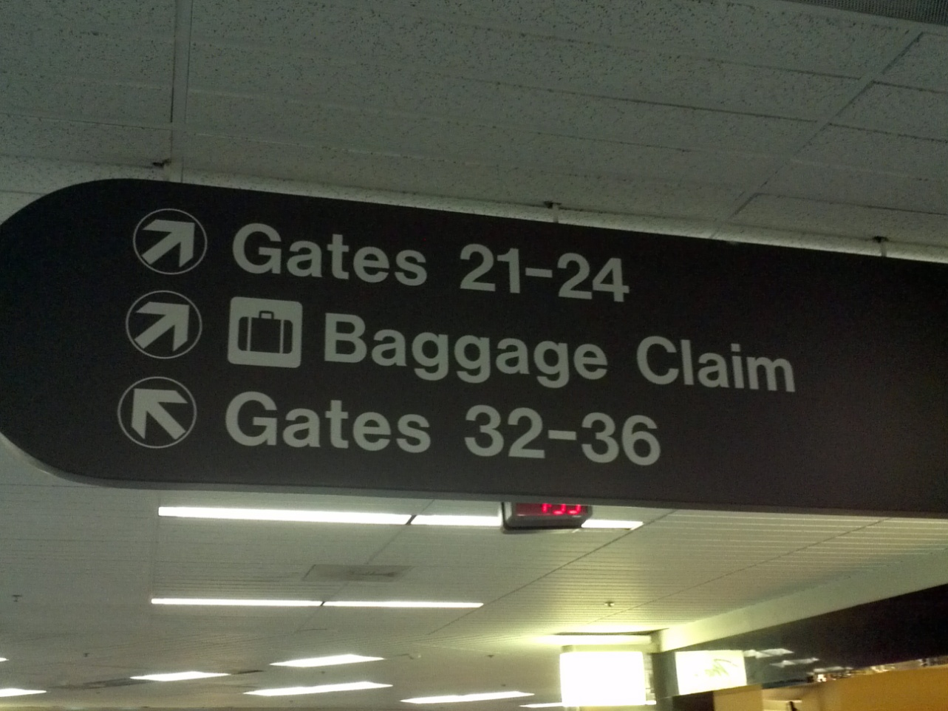
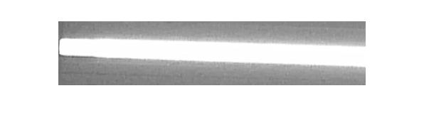
Character Segmentation

Slide 14
Optical Character Recognition
MACE filters
One for each character
[rework better: (Try to find correlated points)]
PCA -> SVM
[][][]
Direct SVM

Slide 15
MACE filters
Pros
[]
[]
Cons
[]
[]

Slide 16
PCA -> SVM
Pros
[]
[]
Cons
[]
[]

Slide 17
Direct SVM
Pros
[]
[]
Cons
[]
[]

Slide 18
Translation
Google API v2
Cheap
Issues
Java
Eclipse
Solution
JavaScript
Representational State Transfer (REST)

Slide 19
Final Demo
[What it’ll do]

Slide 20
Revised Schedule
Week | Alex | James | Tom
4/1 | Test OCR in MATLAB | Implement Segmentation | Implement OCR in C and MATLAB
4/8 | Design Interface | Implement OCR in C | Implement OCR in C
4/15 | Integrate Translation | Finalize GUI | Finalize GUI
4/22 | Demo prep | Demo prep | Demo prep

Slide 21
References
[][][]

